Slide 1
SCI Recovery CS 6460: Ed. Tech
MILESTONE #2
By dhruv Kapoor, Tolga Saygi, clark xu

Slide 2
Purpose
To create a mobile application based on information surrounding spinal cord injuries (SCIs)
To provide educational content on the difficulty of predicting recovery following such injuries
To engage in novel research around predicting SCI recovery with respect to the ASIA impairment scale, which has widespread medical usage
To plug in predictive machine learning into the application so inference can be run for provided patient details
Notes:
5 stages, abcde, a is most severe with no motorsensory function
Will be demonstrated

Slide 3
Recap From Milestone #1
NSCISC dataset was retrieved, which had ~30,000 patient samples from the United States
Extensive programmatic mapping was done by referencing a data dictionary so that data values could be translated into understandable names
Exploratory data analysis was performed to identify problematic data features in terms of missing values and abnormally prevalent values
Mobile application was scaffolded with different screens and text
Ubuntu server, which will host the ML model and inference API, was created with a basic Falcon endpoint that was accessible through a REST call

Slide 4
Progress: Model Training
There was extensive work done to tune different models in order to achieve the highest accuracy on predicting ASIA score
The train:test split was roughly 90:10 and test data started for injuries since 2006
Training results:
Model | Train Accuracy (%) | Test Accuracy (%)
Elastic Net | 82.0 | 72.0
Logistic Regression | 82.0 | 71.8
Random Forest | 94.2 | 69.8
KNN | 83.5 | 69.6
Gradient Boost | 86.2 | 67.2
Decision Tree | 94.2 | 60.9
AdaBoost | 72.4 | 49.8
Gaussian NB | 48.2 | 27.6
Notes:
After trailing different variations of hyperparamaters for each of these, our best model was elastic net with 72% on the test accuracy

Slide 5
Progress: Ubuntu Server
Python environment manifest was created for Windows and Ubuntu so cross-platform development can translate between team members and the server
Inference API was created on the server to take in prediction requests and output an ASIA classification
The inference code itself was written to pull any model we have trained with ease since the training features are consistent across them all
More on this…

Slide 6

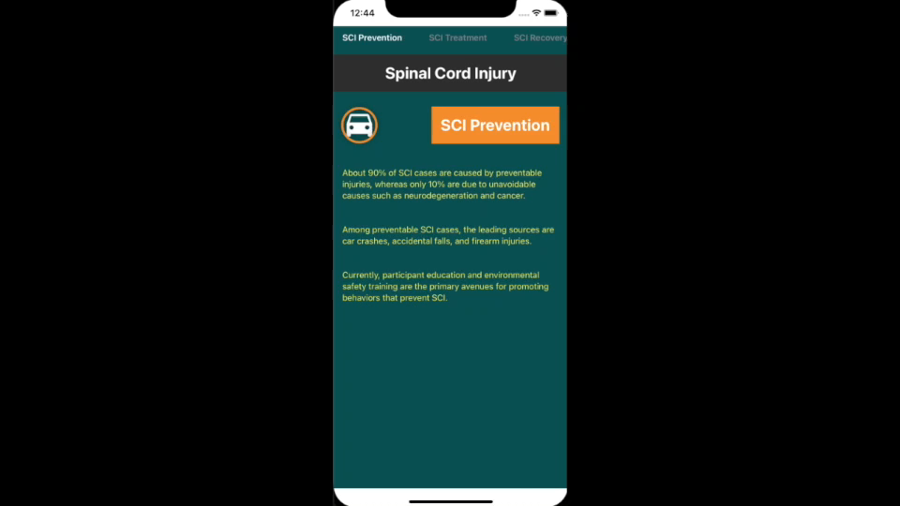
Progress: Mobile App
Notes:
Pages to tabs, more information, inference client

Slide 7
Next Steps
To research and implement variable importance to provide further education into how certain features can impact recovery predictions
To incorporate variable importance results on the mobile application
To continue iterating on the static educational content on the mobile application
To refine any mobile application design decisions in terms of how content is displayed

